Slide 1
Advanced Web programming
Lec-15
Unit 3
Styles, Themes, and Master Pages

Slide 2
Outline
Session State
Application State
Styles, Themes, and Master Pages :
Styles,
Themes,
Master Page Basics,
Advanced Master Pages,

Slide 3
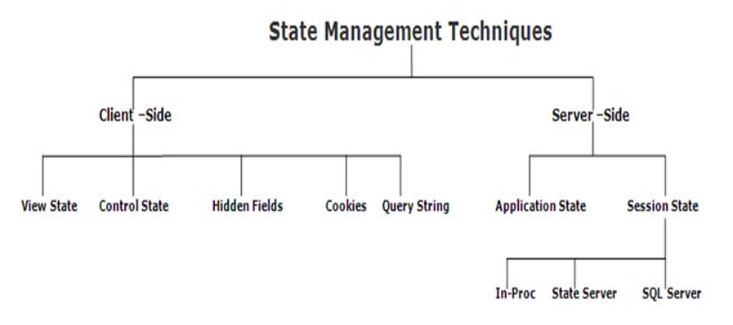
Server side state management system - ASP.NET
https://www.tutorialride.com/asp-net/server-side-state-management-system-asp-net.htm
There are two important objects which work on server.
Session - https://www.c-sharpcorner.com/UploadFile/78d182/Asp-Net-state-management-techniques/
Application - https://www.c-sharpcorner.com/UploadFile/78d182/Asp-Net-state-management-techniques/

Slide 4
How to use Query String and session state-
https://www.msdotnet.co.in/2013/10/how-to-use-query-string-in-aspnet.html#.X42LodAzZPY
https://www.msdotnet.co.in/2013/10/how-to-use-session-state-in-aspnet.html#.X42K09AzZPY
HOW TO COUNT NUMBER OF TIMES WEBSITE VISITED AND ONLINE USERS IN ASP.NET USING C#
To count the number of active visitors on your ASP.NET website.-
https://www.c-sharpcorner.com/UploadFile/cd3aa3/7526/
https://www.aspdotnet-suresh.com/2013/11/asp-net-count-number-of-visitors-in-Website.html
https://www.webcodeexpert.com/2013/10/how-to-count-number-of-times-website.html

Slide 5
Using the techniques you’ve learned so far, you can create polished web pages and let users surf from one page to another.
Styles are part of the Cascading Style Sheet (CSS) standard.
They aren’t directly tied to ASP.NET, but they’re still a great help in applying consistent formatting across your entire website.
Styles are useful, but there are some things they just can’t do.
Because styles are based on the HTML standard, they have no understanding of ASP.NET concepts like control properties.
To fill the gap, ASP.NET includes a themes feature, which plays a similar role to styles but works exclusively with server controls.
Much as you use styles to automatically set the formatting characteristics of HTML elements, you use themes to automatically set the properties of ASP.NET controls.
Another feature for standardizing websites is master pages. Essentially, a master page is a blueprint for part of your website.
Using a master page, you can define web page layout, complete with all the usual details such as headers, menu bars, and ad banners.
Once you’ve perfected a master page, you can use it to create content pages. Each content page automatically acquires the layout and the content of the linked master page.

Slide 6
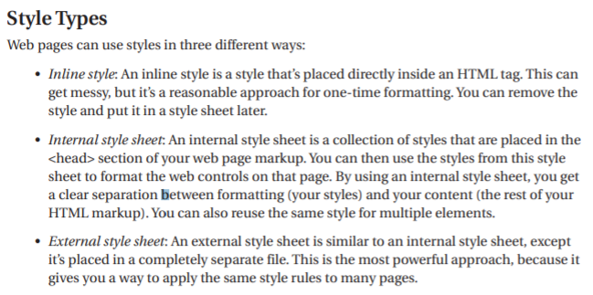
Styles

Slide 7
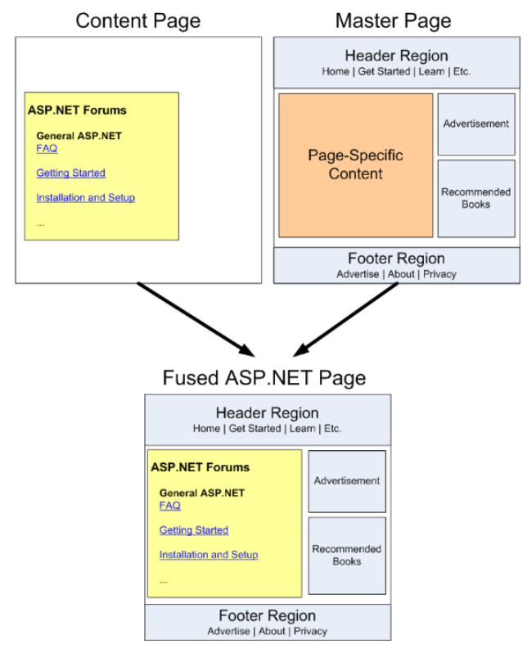

Slide 8
ASP.NET Web Forms - Master Pages
Master pages provide templates for other pages on your web site.
Master pages allow you to create a consistent look and behavior for all the pages (or group of pages) in your web application.
A master page provides a template for other pages, with shared layout and functionality.
The master page defines placeholders for the content, which can be overridden by content pages.
The output result is a combination of the master page and the content page.
The content pages contain the content you want to display.
When users request the content page, ASP.NET merges the pages to produce output that combines the layout of the master page with the content of the content page.

Slide 9
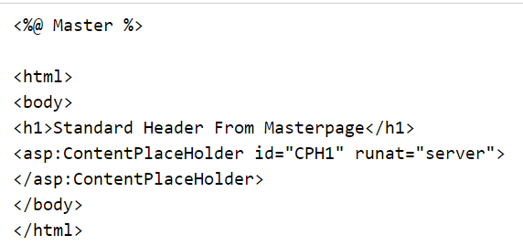
Master Page Example

Slide 10
The master page above is a normal HTML page designed as a template for other pages.
The @ Master directive defines it as a master page.
The master page contains a placeholder tag <asp:ContentPlaceHolder> for individual content.
The id="CPH1" attribute identifies the placeholder, allowing many placeholders in the same master page.
This master page was saved with the name "master1.master".

Slide 11
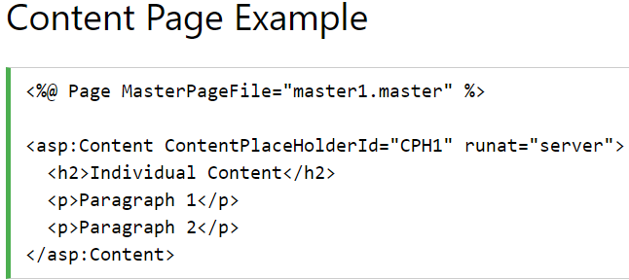
Content Page
The content page above is one of the individual content pages of the web.
The @ Page directive defines it as a standard content page.
The content page contains a content tag <asp:Content> with a reference to the master page (ContentPlaceHolderId="CPH1").
This content page was saved with the name "mypage1.aspx".
When the user requests this page, ASP.NET merges the content page with the master page.

Slide 12
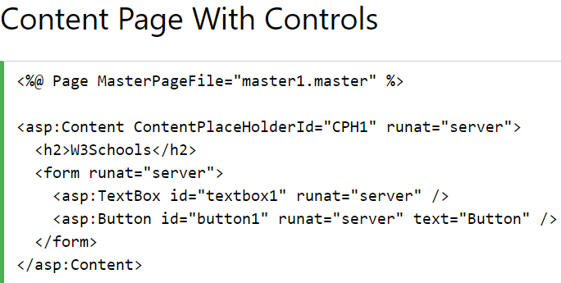
Content Page With Controls
The content page above demonstrates how .NET controls can be inserted into the content page just like an into an ordinary page.

Slide 13
https://www.c-sharpcorner.com/article/how-to-create-master-page-in-asp-net/
https://practiceaspnet.wordpress.com/2015/09/18/master-pages-in-asp-net/

Slide 14
To be continued….

Slide 15
Lec (23/10/20) quiz
https://forms.gle/LpRr1HS1UVqpTXM2A

